Slide 1

CITY UNIVERSITY Department of Computer Science and Engineering Spring 2023 CSE 311: Database Management System
Presentation On
Book Shop Management System
Presented To
Mst – Ayesha Siddka
Assistant Professor
Faculty of Science and Engineering
Department of Computer Science and Engineering
Presented By
Sohan Rana Apurbo(2115602015)
Israt Jahan Santa(2115602023)
Tahmeedul Islam(2125702012)

Slide 2
Contents
Introduction
Objectives
Language & Tools
Features
Relational Database
ER Diagram
Overview of Project
Advantage
Disadvantages
Future Work
Conclusion
Reference

Slide 3
Introduction
Book Management
Inventory Management
Sales management
Customer Relationship Management
User-friendly Interface

Slide 4
Objectives
To search the availability of books.
To know the details of customers.
To provide customer’s better service.
It keeps database of price, sales record.
Processing a large amount of data more effectively and efficiently.

Slide 5
Language & Tools
HTML
CSSS
Bootstrap
Php
MySQL

Slide 6
Features
Login Functionality
Selling Books
Managing Books
Search Books by names, writer & category

Slide 7
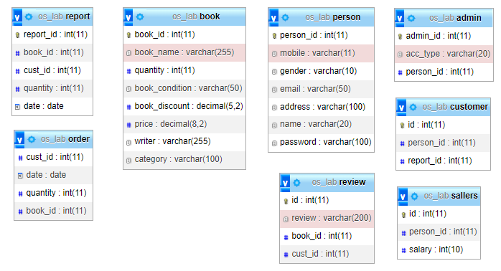
Relational database

Slide 8
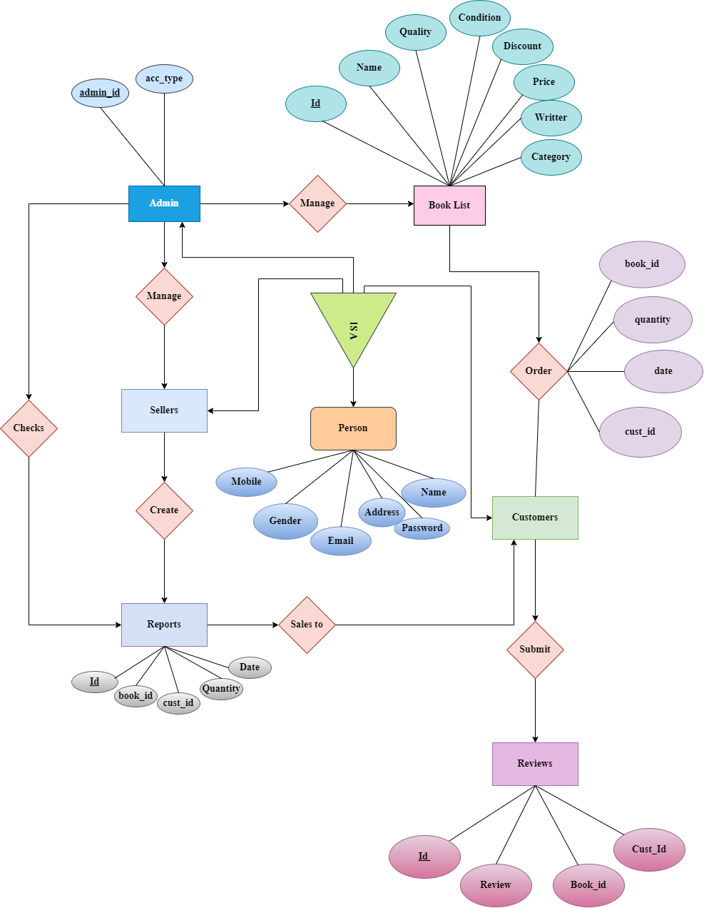
Er Diagram

Slide 9
Overview of project

Slide 10
Advantages
Efficient Inventory Management
Enhanced Sales Tracking
Improved Customer Management
Accurate Pricing
Streamlined Operations

Slide 11
Disadvantages
Initial Cost and Implementation
Learning Curve
Technical Issues and Downtime
Dependency on Technology
Data Security and Privacy Concerns
Limited Customization

Slide 12
Future work
Integration with E-commerce Platforms
Enhanced Data Analytics and Business Intelligence
Mobile and Cloud-based Solutions
Automation and Artificial Intelligence
Enhanced Customer Engagement
Blockchain for Transparency and Authentication

Slide 13
Conclusion
A well-implemented book shop management system can significantly contribute to the success and growth of a bookstore, allowing it to operate efficiently, deliver excellent customer experiences, and adapt to the evolving market trends in the book industry.

Slide 14
References
https://scholar.google.com/
https://repository.au.edu/bitstream/6623004553/4514/1/AU-Project-Report-Fulltext-124678.PDF
http://utpedia.utp.edu.my/id/eprint/24035/1/Online%20Book%20Store%20System.pdf
https://repository.au.edu/bitstream/6623004553/4097/1/AU-Project-Report-Fulltext-167473.PDF
Chat GPT

Slide 15
Thank you
Q & A

